Slide 1


WEBSITE PHISHING DETECTION SYSTEM USING ML TECHNIQUES
Project Proposal Presentation
by
Guhan K S (2348519)
Department of Computer Science
CHRIST(Deemed to be University), Bengaluru-29

Slide 2

CONTENT
What is meant by the Phishing the website
Cyber Tools to handle Website Phishing
AI based Technique to Website Phishing
Machine Learning technique Used
Dataset Used
Code Implementation
Results and Discussion
Advantages
Future Directions
Conclusion

Slide 3
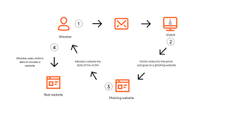
What is meant by the Phishing
●Phishing is a form of fraud in which the attacker tries to learn sensitive information such as login credentials or account information by sending as a reputable entity or person in email or other communication channels.
●Typically a victim receives a message that appears to have been sent by a known contact or organization.
The message contains malicious software targeting the user’s computer or has links to direct victims to malicious websites in order to trick them into divulging personal and financial information, such as passwords, account IDs or credit card details.

Slide 4
What is meant by the Phishing the website
Phishing websites are malicious online platforms crafted by cybercriminals to steal sensitive information.
Users typically access these sites after clicking on malicious links in emails or other messages.
Phishing sites are often created with spoofed domains or by compromising legitimate websites through techniques like water-holing.
Cybercriminals employ diverse tactics on these sites, including prompting users to enter login credentials, financial details, or to download malicious files.
Common objectives of phishing sites include account takeover attacks, financial fraud, and the distribution of malware.

Slide 5
Some Cyber Security Tools To Handle Website Phishing
Netcraft Extension: Real-time protection against phishing sites by checking URLs against a database of known threats.
PhishTank SiteChecker: Allows users to check website reputation against a database of reported phishing URLs.
Avast Online Security: Blocks phishing sites and other threats, providing real-time protection while browsing.
WOT (Web of Trust): Rates websites based on user reviews, warning users of potentially malicious sites.
Bitdefender TrafficLight: Blocks phishing sites and malware, scanning web pages for threats in real-time.

Slide 6
AI Based Website Phishing Detection
Machine Learning Algorithms: Utilize machine learning algorithms to analyze website features and patterns, enabling the detection of phishing attempts.
Feature Extraction: Extract relevant features from website content, such as URL structure, HTML attributes, and textual content, to train the model.
Training Data: Train the AI model on a large dataset of both legitimate and phishing websites to learn distinguishing characteristics.
Classification: Employ classification techniques to categorize websites as either legitimate or phishing based on learned patterns.
Real-Time Detection: Implement AI models capable of real-time detection to promptly identify and block phishing websites as they are encountered.
Continuous Learning: Incorporate mechanisms for continuous learning to adapt to evolving phishing tactics and improve detection accuracy over time.

Slide 7
Dataset Used Description
#Checking the shape of the dataset
Data0.shape--(10000, 18)
COLUMN IN THE DATASET
Domain: The domain name of the website.
It provides the primary identifier for the website but doesn't directly indicate phishing.
Have_IP: Indicates if the website's URL contains an IP address.
Phishing websites may use IP addresses instead of domain names to evade detection and impersonate legitimate sites.
Have_At: Indicates if the website's URL contains the '@' symbol.
Phishing websites may use deceptive URL structures with '@' symbols to mimic legitimate domains or emails.
URL_Length: Measures the length of the URL.
Phishing URLs tend to be longer and more complex, often containing multiple subdomains and parameters to obfuscate their true intent.
URL_Depth: Measures the depth of the URL path.
Phishing URLs may have deep directory structures to mimic legitimate websites or hide malicious content.

Slide 8
Redirection: Indicates if the website uses URL redirection.
Phishing websites often employ redirection techniques to redirect users to malicious content or other phishing sites.
https_Domain: Indicates if the website's domain uses HTTPS.
Phishing websites may lack HTTPS encryption, increasing the likelihood of data interception or tampering.
TinyURL: Indicates if the website uses URL shortening services.
Phishing URLs often use URL shortening services to obfuscate their true destination and evade detection.
Prefix/Suffix: Indicates if the website's URL contains prefix or suffix characters.
Phishing URLs may include prefix or suffix characters to resemble legitimate domains or deceive users.
DNS_Record: Indicates if the website has DNS records.
Phishing websites may lack DNS records or have irregular DNS configurations, suggesting suspicious activity.
Web_Traffic: Measures the website's web traffic volume.
Phishing websites may have lower web traffic compared to legitimate sites, indicating fewer genuine visitors.

Slide 9
Domain_Age: Measures the age of the website's domain.
Phishing websites may have recently registered domains, indicating a higher likelihood of malicious intent.
Domain_End: Indicates the end of the domain (e.g., '.com', '.org').
Phishing websites may use uncommon or suspicious domain endings to mimic legitimate sites or deceive users.
iFrame: Indicates if the website uses iFrames.
Phishing websites may use hidden iFrames to load malicious content or capture user input without their knowledge.
Mouse_Over: Indicates if the website uses mouse-over events.
Phishing websites may use mouse-over events to trigger malicious actions or display deceptive pop-ups.
Right_Click: Indicates if the website disables right-click functionality.
Phishing websites may disable right-click functionality to prevent users from accessing browser tools or inspecting page elements.
Web_Forwards: Indicates if the website uses web forwards.
Phishing websites may use web forwards to redirect users to malicious content or other phishing sites.

Slide 10
Machine Learning Technique Used
Support Vector Machine (SVM) is a powerful Supervised Machine Learning Algorithm used primarily for classification tasks. It works by finding a hyperplane that best separates different classes of data. In 2-dimensional space, this hyperplane is a line.
SVM inherently performs binary classification, but it can be extended to handle multi-class problems. One approach is to create a binary classifier for each class. Each classifier distinguishes between data points belonging to its class and those that don't. This approach allows SVM to effectively classify data into multiple classes.

Slide 11
Machine Learning Technique Used
Decision Tree is a powerful and popular tool for classification and prediction. It utilizes a flowchart-like tree structure where each internal node represents a test on an attribute, each branch indicates an outcome of the test, and each leaf node holds a class label.
The tree is "learned" by recursively splitting the source set into subsets based on attribute value tests. This process continues until subsets at a node have the same value for the target variable or further splitting doesn't improve predictions.
To classify instances, Decision Trees sort them down the tree from the root to leaf nodes. Starting at the root, the tree tests attributes, and instances move down branches corresponding to attribute values until reaching a leaf node, which provides the classification (e.g., Yes or No).

Slide 12
Machine Learning Technique Used
Random Forest is an ensemble learning method used for classification and regression tasks.
It combines multiple decision trees to improve accuracy and reduce overfitting.
Random Forest works by creating a collection of decision trees, each trained on a bootstrap sample of the data.
At each split in the trees, a random subset of features is considered, enhancing diversity and robustness.
The algorithm is effective in handling missing data and is widely used across various industries such as finance, healthcare, and marketing.

Slide 13
Implementation
PREPROCESSING DATA
EDA (VISUALIZATION FOR THE DATA)
SPLITTING THE DATA INTO TRAIN AND TEST
MODELS APPLIED
RESULTS AND DISCUSSION
ML Model Train Accuracy Test Accuracy
0Decision Tree 0.817 0.8001
Random Forest 0.818 0.8282
Multilayer Perceptrons 0.856 0.8623
SVM 0.800 0.811

Slide 14
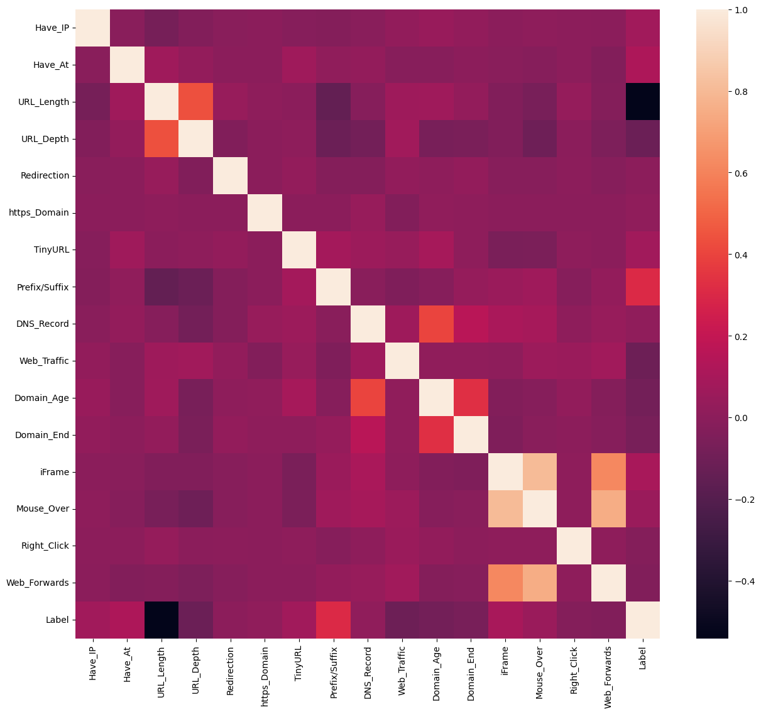
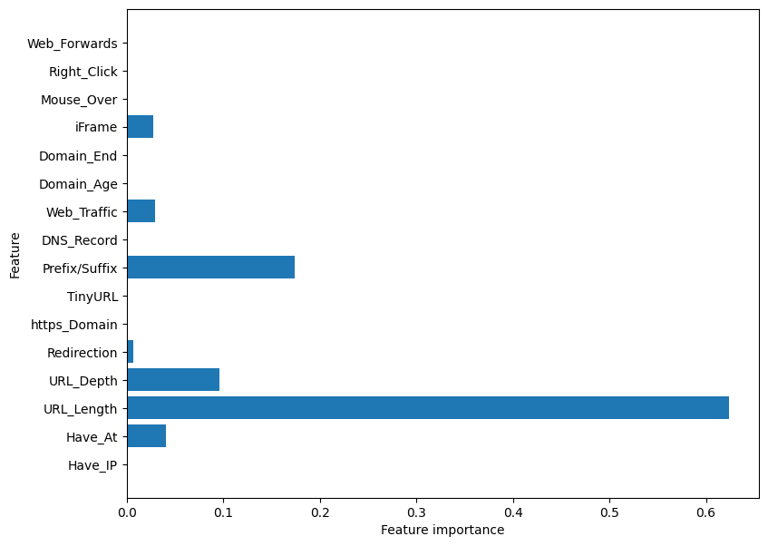
Results And Discussion
ML Model Train Accuracy Test Accuracy
0Decision Tree 0.817 0.8001
Random Forest 0.818 0.8282
Multilayer Perceptrons 0.856 0.8623
SVM 0.800 0.811

Slide 15
Advantages
Deception: Phishing websites can deceive users by mimicking legitimate websites, making it difficult for them to distinguish between real and fake sites.
Easy Access to Credentials: Attackers can easily obtain sensitive information such as login credentials, credit card numbers, and personal details from unsuspecting users who input their information into phishing websites.
Scalability: Phishing attacks can be launched on a large scale, targeting a wide audience simultaneously. Attackers can send out thousands or even millions of phishing emails containing links to malicious websites.
Low Cost: Phishing attacks are relatively inexpensive to execute compared to other forms of cyberattacks. Attackers can use automated tools to create and distribute phishing emails and websites at minimal cost.

Slide 16
Limitations
Dependence on User Interaction: Phishing attacks typically rely on users to take action, such as clicking on a malicious link or providing sensitive information. If users are cautious and well-informed, they may be less likely to fall for phishing scams.
Detection by Security Measures: Advanced security measures, such as email filters, web filters, and anti-phishing software, can detect and block phishing attempts, reducing the effectiveness of such attacks.
Short Lifespan of Phishing Sites: Phishing websites may have a short lifespan as they are often detected and taken down relatively quickly by cybersecurity experts, internet service providers, and domain registrars.
Legal Consequences: Perpetrators of phishing attacks may face legal consequences if caught, including criminal charges and financial penalties, which act as a deterrent.
Trust Erosion: Successful phishing attacks can erode trust between users and legitimate organizations, leading to reputational damage and loss of business for the targeted organizations.

Slide 17
Future Directions
Future directions in combating website phishing attacks may include:
1. Advanced Detection: Developing more sophisticated algorithms for real-time phishing website detection.
2. Behavioral Analysis: Utilizing behavioral analysis to identify phishing patterns and anomalies.
3. Collaborative Efforts: Enhancing collaboration among stakeholders to share threat intelligence and coordinate response efforts.
4. User Education: Increasing user awareness and education about phishing threats and prevention techniques.
5. Technological Solutions: Innovating new technologies like browser extensions for real-time protection against phishing.
6. Regulatory Measures: Advocating for stronger regulations to deter phishing activities and hold perpetrators accountable.
7. Continued Research: Investing in ongoing research to stay ahead of evolving phishing techniques and trends.

Slide 18
References
https://colab.research.google.com/github/shreyagopal/Phishing-Website-Detection-by-Machine-Learning-Techniques/blob/master/Phishing%20Website%20Detection_Models%20%26%20Training.ipynb#scrollTo=gBMqupCMM74V
https://www.kaggle.com/code/essammohamed4320/intrusion-detection-system-with-ml-dl

Slide 19
THANK YOU

